Slide 1
ON ROAD VEHICLE BREAKDOWN ASSISTANCE
ABHIJITH M
Roll No: MES20MCA2002
PRODUCT OWNER : Prof. K P BALACHANDRAN

Slide 2
TABLE OF CONTENTS
Introduction
Modules
Methodology
Developing Environment
Product Backlog
User Stories
Project Plan
Sprint Plans
Sprint Actual

Slide 3
ON ROAD VECHICLE BREAKDOWN ASSISTANCE
On Road Vehicle Breakdown Assistance (ORVBA) is going to be a good solution for the people who seek help in the remote locations with mechanical issues of their vehicle. Users of the On Road Vehicle Breakdown Assistance will be the registered public and they be getting connected with the particular mechanic through the trustworthy On Road Vehicle Breakdown Assistance (ORVBA) system. Because only the Experienced and approved mechanics are enlisted in the On Road Vehicle Breakdown Assistance (ORVBA) system. Also they are under monitoring by the ORVBA system for not charging any extra service fee from the users as every user is updating their feedback about the availed service through ORVBA system.

Slide 4
MODULES
ADMIN
Login
View mechanic
Manage mechanic
View complaint & post reply
View feedback
USER
Register
Login
View mechanic & search
Request service
Post complaints
View reply
Feedback
Rate mechanic
View rating

Slide 5
MODULES
MECHANIC
Registration
Login
Post business
Manage business
View request & manage
Track user
View feedback

Slide 6
METHODOLOGY
On Road Vehicle Breakdown Assistance is a mobile application user can find mechanic basis on user location easily. The user logging in to the App after User Registration. Then User current location track by GPS. Then user location goes to DB and match with the mechanic who registered with the App. There is shown mechanic that nearest to user location.
The application contains 2 part web part and mobile part. web part is admin section and mobile part containing mechanic and user section. Web part is implemented using python django . Django is high level python web framework that enable rapid development of secure and maintainable website . The mobile part is implemented in Flutter . Flutter is an open source UI software development kit created by Google. Database will configure in web part the data exchange will occur with the help of Rest API layer .

Slide 7
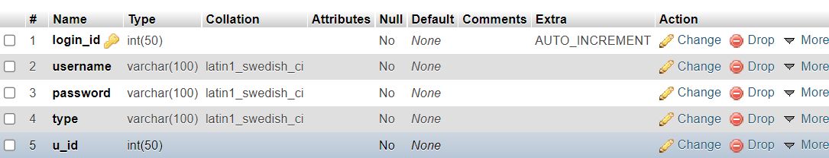
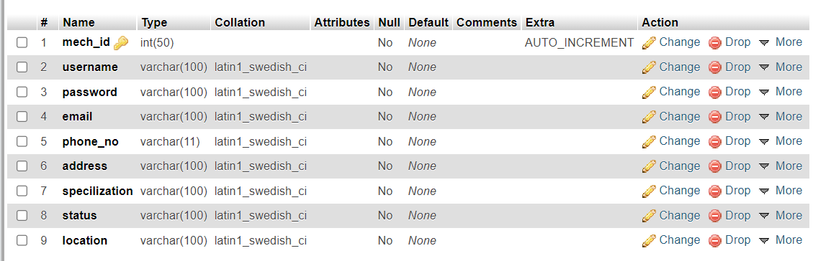
TABLES
Login
Mechanic

Slide 8
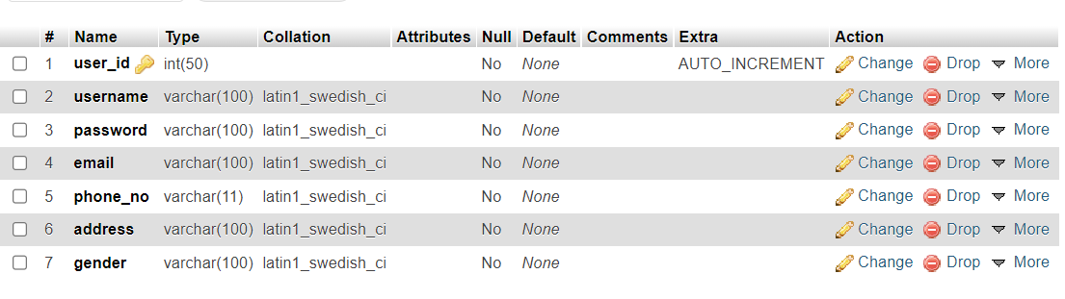
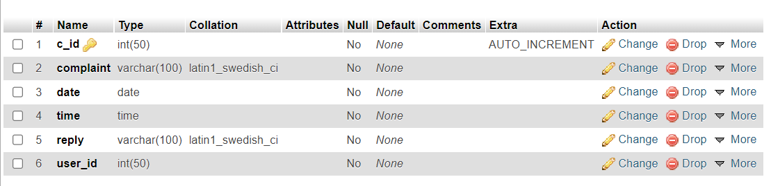
User
Complaint

Slide 9
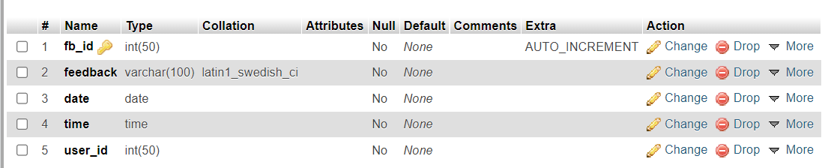
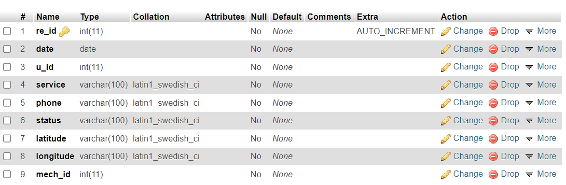
Feedback
Service request

Slide 10
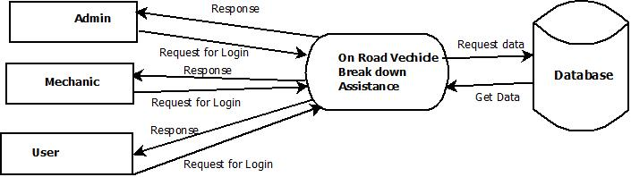
DATA FLOW DIAGRAM
LEVEL 0

Slide 11
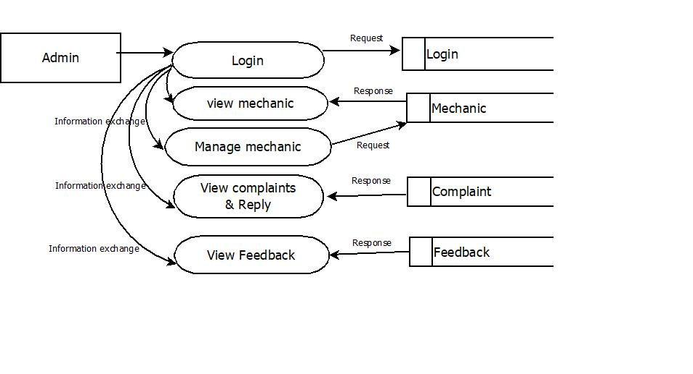
DATA FLOW DIAGRAM
LEVEL 1

Slide 12
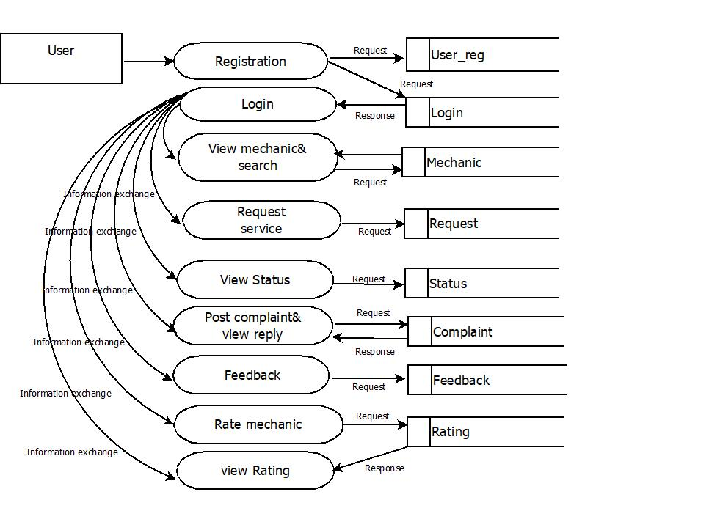
DATA FLOW DIAGRAM
LEVEL 2

Slide 13
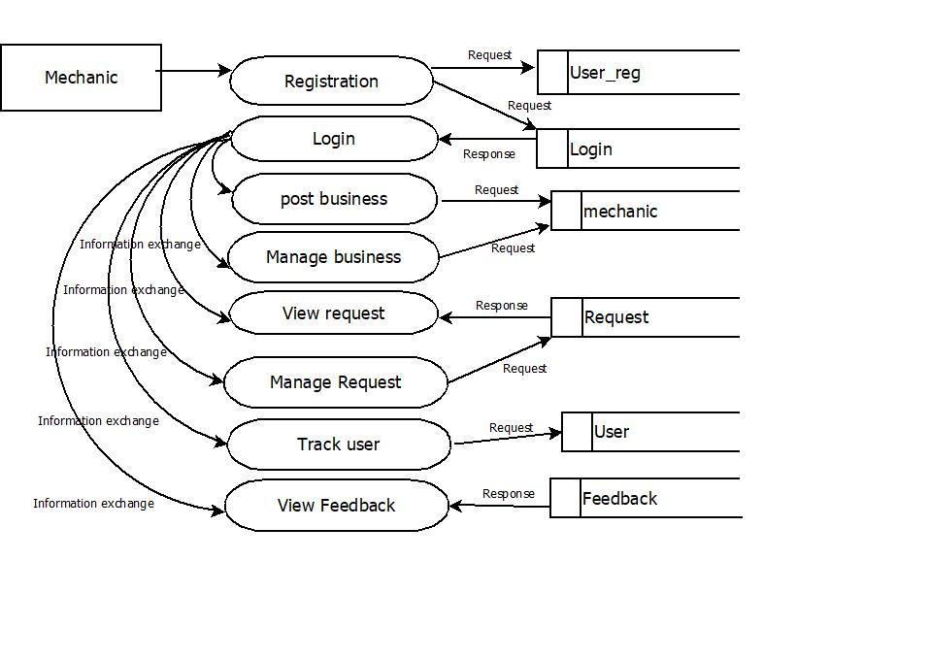
DATA FLOW DIAGRAM
LEVEL 3

Slide 14
DEVELOPING ENVIRONMENT
Front End : Flutter
Back end : Python- django
Database : MySQL
IDE : PyCharm , Android studio
OS : Windows/Linux
Processor : i5
RAM : 8GB

Slide 15
PROJECT PLAN
User Story ID | Task Name | Start Date | End Date | Days | Status
1 | Sprint 1 | 20/04/2022 | 21/04/2022 | 4 | Completed
2 |  | 25/04/2021 | 26/04/2022 |  | Completed
3 | Sprint 2 | 29/04/2022 | 29/04/2022 | 8 | Completed
4 |  | 01/05/2022 | 01/05/2022 |  | Completed
5 |  | 04/05/2022 | 05/05/2022 |  | Completed
6 |  | 12/05/2022 | 13/05/2022 |  | Completed
7 |  | 23/05/2022 | 24/05/2022 |  | Completed
8 | Sprint 3 | 24/05/2022 | 25/05/2022 | 10 | Complete
9 |  | 28/05/2022 | 29/05/2022 |  | Complete
10 |  | 30/05/2022 | 30/05/2022 |  | Complete
11 |  | 01/06/2022 | 02/06/2022 |  | Complete
12 |  | 03/06/2022 | 03/06/2022 |  | Complete
13 |  | 05/06/2022 | 06/06/2022 |  | Complete
14 | Sprint 4 | 15/06/2022 | 16/06/2022 | 6 | Complete
15 |  | 18/6/2022 | 19/6/2022 |  | Complete
16 |  | 25/6/2022 | 26/6/2022 |  | Complete

Slide 16
PRODUCT BACKLOG
User story ID | Priority <High/Medium/Low> | Size (Hours) | Sprint <#> | Status <Planned/In progress/Completed> | Release Date | Release Goal
1 | Medium | 3 | 1 | Completed | 21-04-2022 | Admin want to login
2 | High | 3 |  | Completed | 26-04-2022 | Admin want to view mechanic
3 | Medium | 3 | 2 | Completed | 29-05-2022 | Admin want to manage mechanic
4 | High | 4 |  | Completed | 01-05 2022 | Admin want to view complaints
5 | Medium | 4 |  | Completed | 05-05-2021 | Admin want to post reply
7 | High | 4 |  | Completed | 13-05-2022 | Admin want to view feedback

Slide 17
PRODUCT BACKLOG
User story ID | Priority <High/Medium/Low> | Size (Hours) | Sprint <#> | Status <Planned/In progress/Completed> | Release Date | Release Goal
8 | Medium | 3 | 3 | Planned | 24-05-2022 | User want to register and login
9 | High | 3 |  | Planned | 25-05-2022 | User want to view mechanic
10 | Medium | 1 |  | Planned | 29-05-2022 | Mechanic want to register and login
11 | Medium | 1 |  | Planned | 30-05-2022 | Mechanic want to post business
10 | High | 3 |  | Planned | 02-06-2022 | Mechanic want to manage business
12 | High | 4 |  | Planned | 03-06-2022 | User want to request service
13 | Medium | 3 |  | Planned | 06-06-2022 | Mechanic want to view the request and manage
14 | Medium | 3 | 4 | Planned | 08-06-2022 | Mechanic want to track the user
15 | Medium | 1 |  | Planned | 16-06-2022 | User want to post complaints and view reply
16 | Medium | 1 |  | Planned | 18-06-2022 | User want to rate the mechanic and view rating
17 | Medium | 1 |  | Planned | 26-06-2022 | Mechanic want to view feedback

Slide 18
USER STORY
User story ID | As a <type of user> | I want to <perform some task> | So that I can <achieve some goal>
1 | Admin | Access home page and login | Home page of admin access the system
2 | Admin | Access mechanic details | Admin can view the mechanic profile
3 | Admin | Verify the mechanic details | Mechanic can enter into the application
4 | Admin | View complaint | Admin can view the complaint
5 | Admin | Post reply | User can view reply
6 | Admin | View feedback | View users feedback
7 | User | Register and Login | User need to register and login
8 | User | View mechanic | User can view available mechanic
9 | Mechanic | Register and login | Mechanic need to register and wait for approval
10 | Mechanic | Post business | User can view the details of mechanic

Slide 19
USER STORY
User Story ID | As a type of User | I want to <perform some task> | So that I can < Achieve Some Goal>
11 | Mechanic | Manage business | User can view updated profile of mechanic
12 | User | Request service | Mechanic view the request
11 | Mechanic | Manage request | Users get the service verify message
12 | Mechanic | Track the user | User get notification mechanic have to start the journey.
13 | User | Post complaint | Admin can view complaint
14 | Admin | View complaint | Admin can View complaint and send response
15 | User | Add Rating | Other user and mechanics can view rating
16 | User | Post feedback | Admin and mechanic can view feedback

Slide 20
SPRINT BACKLOG PLAN
Backlog Item | Status and Completion date | Original Estimate in hours | Day 1 | Day 2 | Day 3 | Day 4 | Day 5 | Day 6 | Day 7 | Day 8 | Day 9 | Day 10 | Day 11 | Day 12 | Day 13
User story #1,2 |  |  | Hours | Hours | Hours | Hours | Hours | Hours | Hours | Hours | Hours | Hours | Hours | Hours | Hours
UI Designing | 20/04/22 | 2 | 2 | 0 | 0 | 0 | 0 | 0 | 0 | 0 | 0 | 0 | 0 | 0 | 0
Database Connectivity | 21/04/22 | 2 | 0 | 2 | 0 | 0 | 0 | 0 | 0 | 0 | 0 | 0 | 0 | 0 | 0
Coding | 24/05/22 | 2 | 0 | 2 | 0 | 0 | 0 | 0 | 0 | 0 | 0 | 0 | 0 | 0 | 0
Testing | 26/05/22 | 2 | 0 | 2 | 0 | 0 | 0 | 0 | 0 | 0 | 0 | 0 | 0 | 0 | 0
User story #3,4,5,6,7
UI Designing | 29/04/22 | 5 | 0 | 0 | 5 | 0 | 0 | 0 | 0 | 0 | 0 | 0 | 0 | 0 | 0
Database Connectivity | 10/06/22 | 3 | 0 | 0 | 0 | 3 | 0 | 0 | 0 | 0 | 0 | 0 | 0 | 0 | 0
Coding | 13/06/22 | 6 | 0 | 0 | 0 | 0 | 6 | 0 | 0 | 0 | 0 | 0 | 0 | 0 | 0
Testing | 24/06/22 | 4 | 0 | 0 | 0 | 0 | 4 | 0 | 0 | 0 | 0 | 0 | 0 | 0 | 0
User story #,8,9,10,11,12,13
UI Designing | 25/06/22 | 4 | 0 | 0 | 0 | 0 | 0 | 4 | 0 | 0 | 0 | 0 | 0 | 0 | 0
Database Connectivity | 28/06/22 | 3 | 0 | 0 | 0 | 0 | 0 | 3 | 0 | 0 | 0 | 0 | 0 | 0 | 0
Coding | 30/06/22 | 3 | 0 | 0 | 0 | 0 | 0 | 0 | 3 | 0 | 0 | 0 | 0 | 0 | 0
Testing | 05/06/22 | 2 | 0 | 0 | 0 | 0 | 0 | 0 | 0 | 2 | 0 | 0 | 0 | 0 | 0
User story #14,15,16
UI Designing | 16/06/22 | 4 | 0 | 0 | 0 | 0 | 0 | 0 | 0 | 0 | 4 | 0 | 0 | 0 | 0
Database Connectivity | 18/06/22 | 2 | 0 | 0 | 0 | 0 | 0 | 0 | 0 | 0 | 0 | 2 | 0 | 0 | 0
Coding | 19/06/22 | 3 | 0 | 0 | 0 | 0 | 0 | 0 | 0 | 0 | 0 | 0 | 3 | 0 | 0
Testing | 26/06/22 | 3 | 0 | 0 | 0 | 0 | 0 | 0 | 0 | 0 | 0 | 0 | 3 | 0 | 0
Total |  | 50 | 2 | 6 | 5 | 3 | 10 | 7 | 3 | 2 | 4 | 2 | 6 | 0 | 0

Slide 21
SPRINT BACKLOG ACTUAL
Backlog Item | Status and Completion date | Original Estimate in hours | Day 1 | Day 2 | Day 3 | Day 4 | Day 5 | Day 6 | Day 7 | Day 8 | Day 9 | Day 10 | Day 11 | Day 12 | Day 13 | Completed <Y/N>
User story #1,2 |  |  | Hours | Hours | Hours | Hours | Hours | Hours | Hours | Hours | Hours | Hours | Hours | Hours | Hours
UI Designing | 20/04/22 | 2 | 2 | 0 | 0 | 0 | 0 | 0 | 0 | 0 | 0 | 0 | 0 | 0 | 0 | Y
Database Connectivity | 21/05/22 | 2 | 0 | 2 | 0 | 0 | 0 | 0 | 0 | 0 | 0 | 0 | 0 | 0 | 0 | Y
Coding | 24/05/22 | 2 | 0 | 2 | 0 | 0 | 0 | 0 | 0 | 0 | 0 | 0 | 0 | 0 | 0 | Y
Testing | 26/05/22 | 2 | 0 | 2 | 0 | 0 | 0 | 0 | 0 | 0 | 0 | 0 | 0 | 0 | 0 | Y
User story #3,4,5,6,7
UI Designing | 29/05/22 | 5 | 0 | 0 | 5 | 0 | 0 | 0 | 0 | 0 | 0 | 0 | 0 | 0 | 0 | Y
Database Connectivity | 10/05/22 | 3 | 0 | 0 | 0 | 3 | 0 | 0 | 0 | 0 | 0 | 0 | 0 | 0 | 0 | Y
Coding | 13/05/22 | 6 | 0 | 0 | 0 | 0 | 6 | 0 | 0 | 0 | 0 | 0 | 0 | 0 | 0 | Y
Testing | 24/05/22 | 4 | 0 | 0 | 0 | 0 | 4 | 0 | 0 | 0 | 0 | 0 | 0 | 0 | 0 | Y
User story #8,9,10,11,12,13
UI Designing | 25/05/222 | 4 | 0 | 0 | 0 | 0 | 0 | 4 | 0 | 0 | 0 | 0 | 0 | 0 | 0 | Y
Database Connectivity | 28/05/22 | 3 | 0 | 0 | 0 | 0 | 0 | 3 | 0 | 0 | 0 | 0 | 0 | 0 | 0 | Y
Coding | 30/05/22 | 3 | 0 | 0 | 0 | 0 | 0 | 0 | 3 | 0 | 0 | 0 | 0 | 0 | 0 | Y
Testing | 05/01/22 | 2 | 0 | 0 | 0 | 0 | 0 | 0 | 0 | 2 | 0 | 0 | 0 | 0 | 0 | Y
User story #14,15,16
UI Designing | 16/06/22 | 4 | 0 | 0 | 0 | 0 | 0 | 0 | 0 | 0 | 4 | 0 | 0 | 0 | 0 | Y
Database Connectivity | 18/06/22 | 2 | 0 | 0 | 0 | 0 | 0 | 0 | 0 | 0 | 0 | 2 | 0 | 0 | 0 | Y
Coding | 19/06/22 | 3 | 0 | 0 | 0 | 0 | 0 | 0 | 0 | 0 | 0 | 0 | 3 | 0 | 0 | Y
Testing | 26/06/22 | 3 | 0 | 0 | 0 | 0 | 0 | 0 | 0 | 0 | 0 | 0 | 3 | 0 | 0 | Y
Total |  | 50 | 2 | 6 | 5 | 3 | 10 | 7 | 3 | 2 | 4 | 2 | 6 | 0 | 0 | Y

Slide 22
THANK YOU

